Slide 1
TABLEAu CAPSTONE PROJECT VIDEO GAME SALES ANALYSIS DASHBOARD
BY: POOJA PAL
B.TECH(CSE)

Slide 2
PROBLEM STATEMENTS
Best selling genres on plateforms
Top publishers, genres, plateforms and sold games
Global vs other sales in all the years
Global vs other sales on sold games
Game published by genres in all the years
Sales by region
Average of total sales.
Source of data : www.Kaggle.com

Slide 3
Executive Summary
In this project I am trying to find out the most popular sold games, publishers, plateforms by sales and also to identify best selling genres on plateforms and find out genre sales by each region and to identify average of total sales, it consist data of video games sold since 1980 to 2020 with 12 fields and 16598 rows with their publishers, plateforms and genre of games on which year they were published with the sales they made in Europe, Japan, North America and other Regions.
Link of Tableau file :
https://public.tableau.com/views/TableauCapstoneProject_16398469159780/Dashboard1?:language=en-US&:display_count=n&:origin=viz_share_link

Slide 4
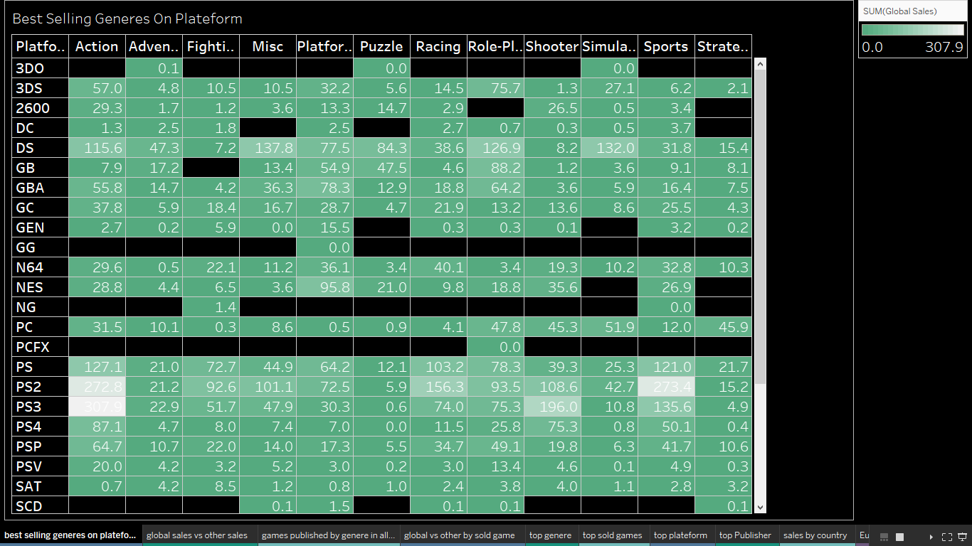
Data analysis
Best Selling Genres On Plateforms,
Visualize by heat map to show which genres has the maximum sales on which plateform, you can see that Action genre has the maximum sales on PS2,PS3 & DS plateform and continues with the Sports genre i.e. PS2,PS3,DS is the best selling genre.

Slide 5
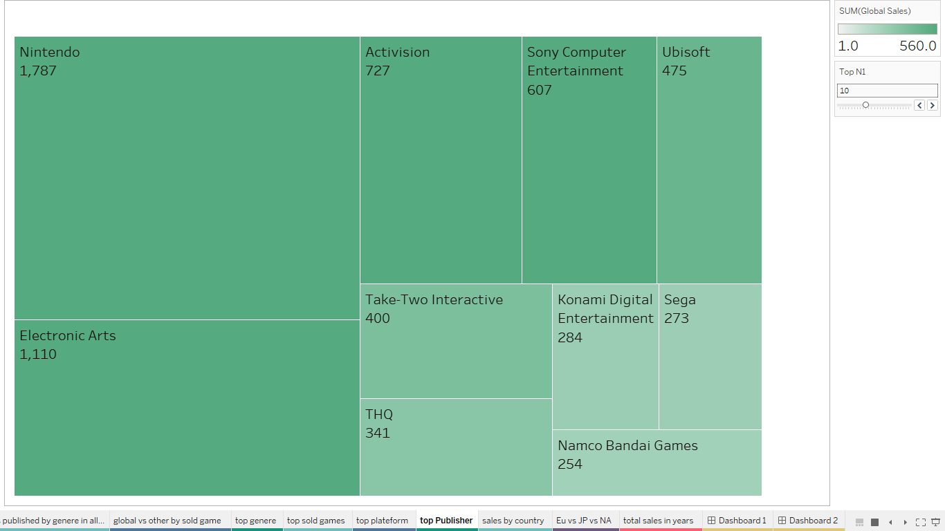
Data analysis contd…
Top Publishers,
This tree map analysis shows the top publishers by globally, you can see that Nintendo is the winner but also Electronic arts ,Activision and Sony computer entertainment played well.

Slide 6
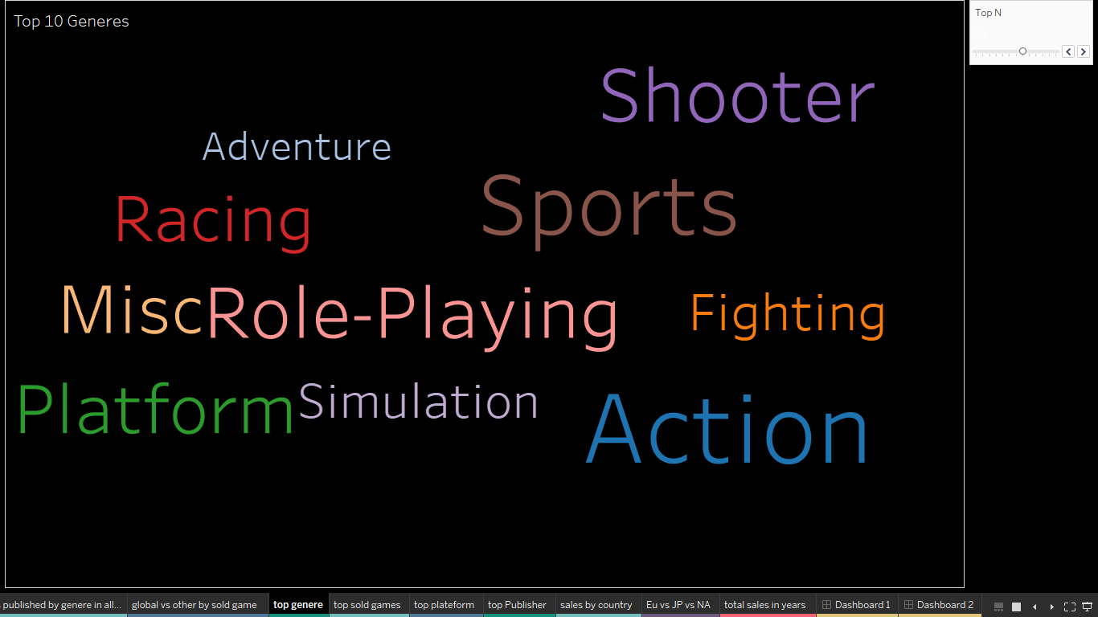
Data analysis contd…
Top Genre,
Visualize by word cloud to display genres , Action is the genre that contributes the most to sales and continues with the sports genre

Slide 7
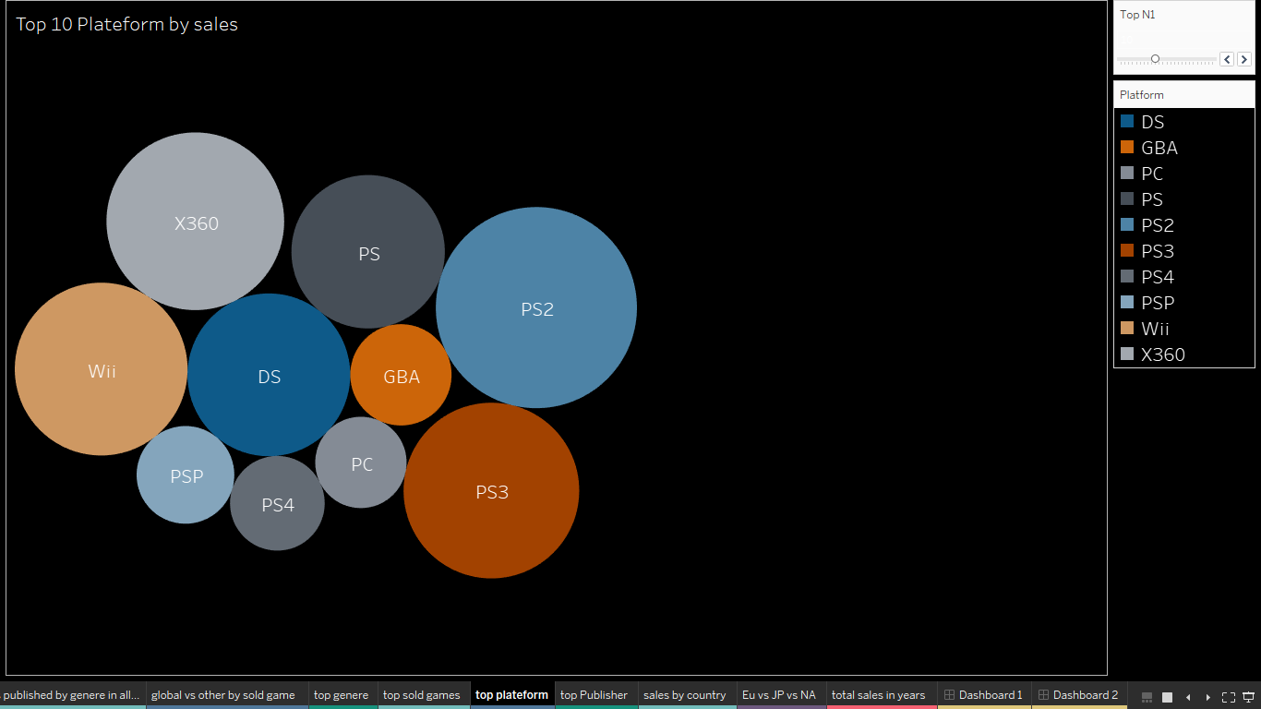
Data analysis contd…
Top plateforms,
Visualize by bubble chart to show which plateform are the most popular, you can see in this chart PS2 is the most purchased plateform

Slide 8
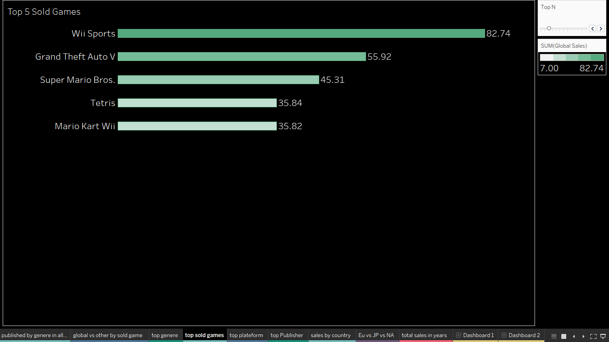
Data analysis contd…
Top Sold Games,
Visualize by horizontal bar chart which display the most purchased games and you can see in this chart Wii Sports holds the first place.

Slide 9
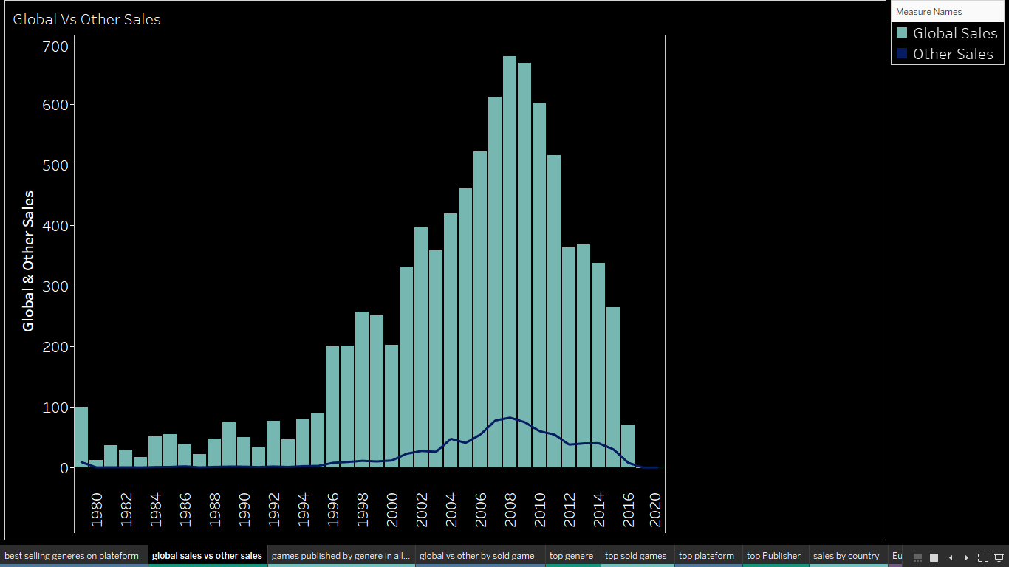
Data analysis contd…
Global vs other sales in all the years,
Visualize by dual axis chart to show which year has maximum global sales and other sales ,It shows clearly that in 2008 both has max sales and from 2008 sales has been decreased

Slide 10
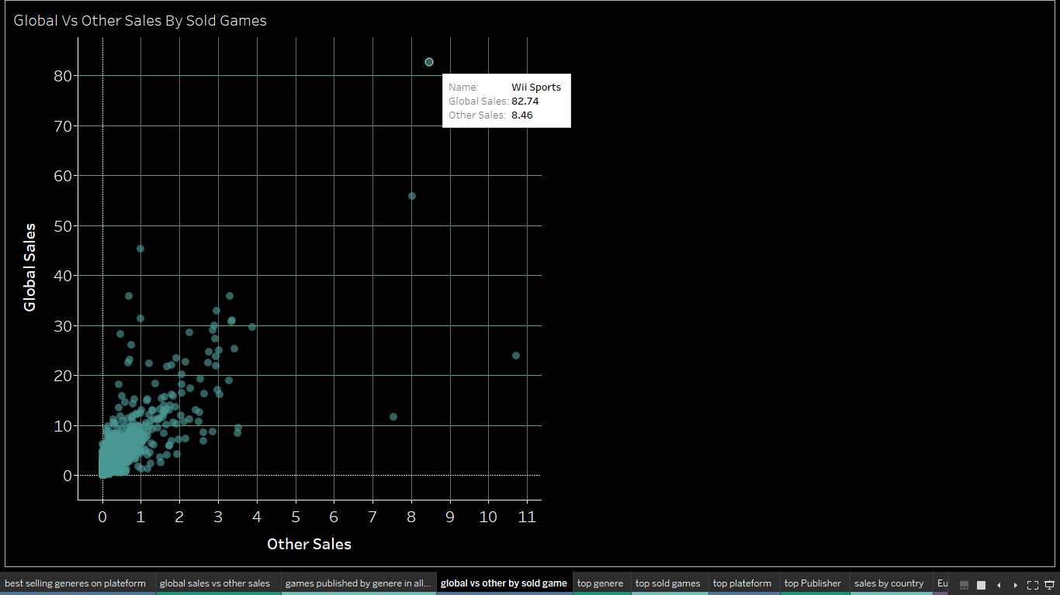
Data analysis contd…
Global vs other sales on sold games,
Visualize by scatter plot to display the global sales and other sales on sold games, Wii Sports game has maximum sales

Slide 11
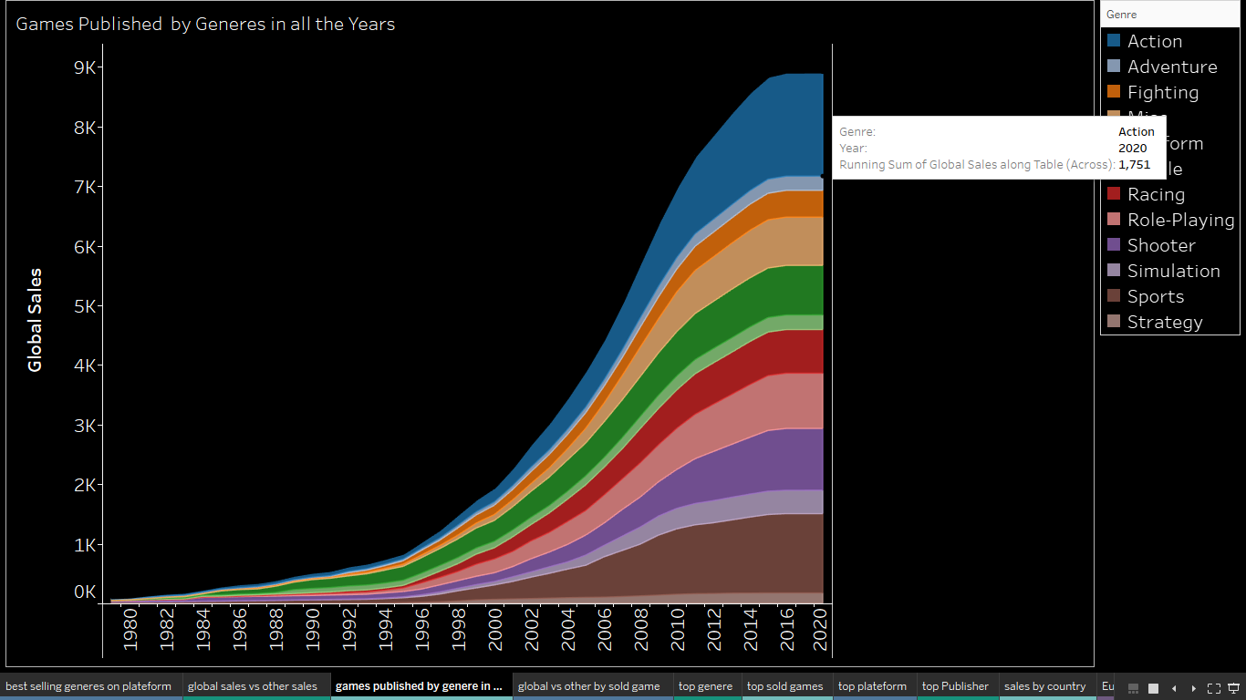
Data analysis contd…
Game published by genres in all the year,
Visualize by area chart to display the most sold genre by year , In 2020, Action is the most demanded genre

Slide 12
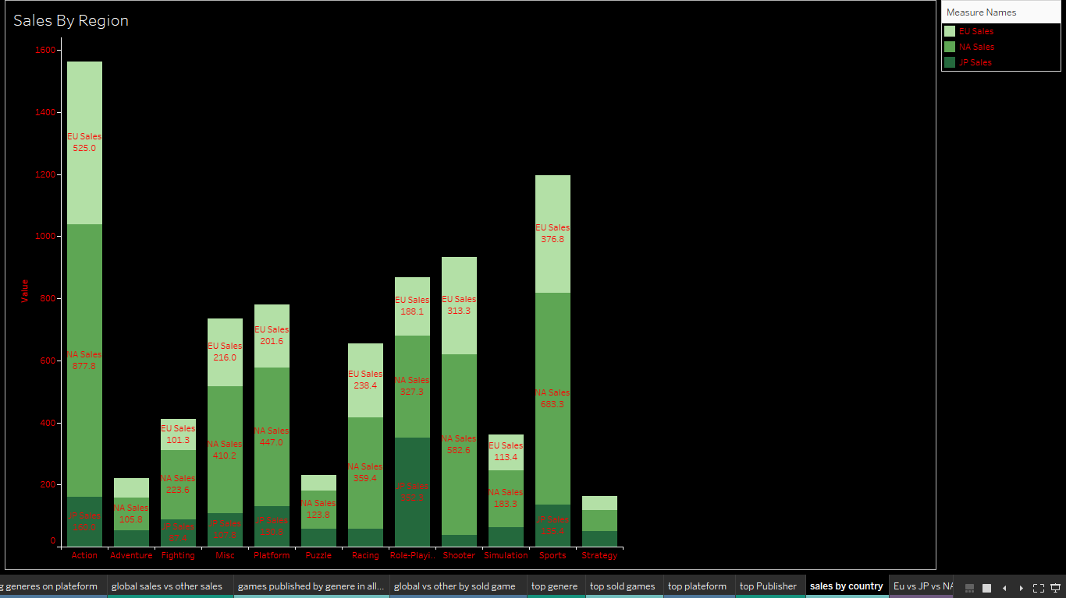
Data analysis contd…
Sales by Region,
Visualize by stacked bars to display the sales in each regions like Europe, Japan and North America, most popular video games lovers are from North America and other region also display a vital role

Slide 13
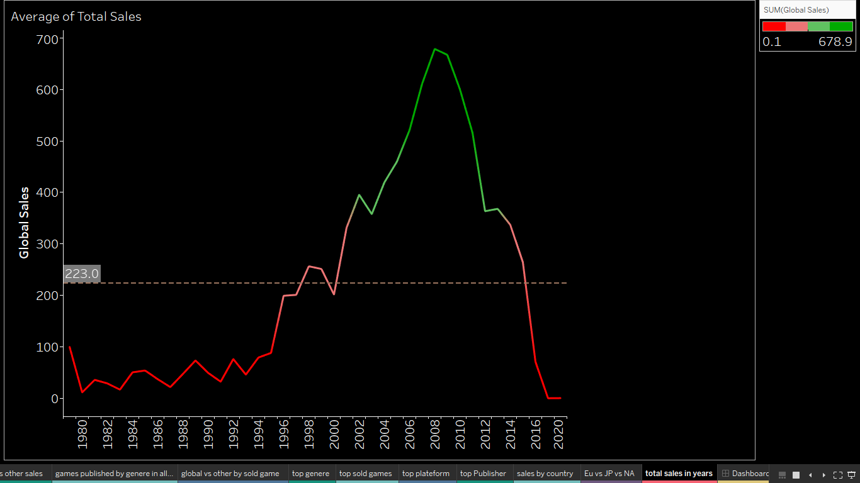
Data analysis contd…
Average of total sales,
Visualize by line chart to display the overall sales of video games, 2008 is the peak year where it shows the highest sales and it shows the average line of total sales ,in this graph green indicating the highest sales and red shows lowest sales

Slide 14
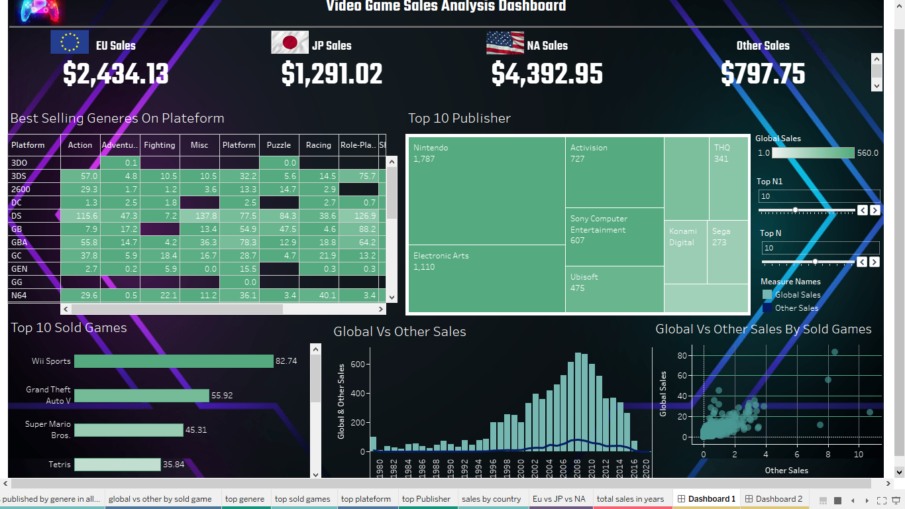

Slide 15
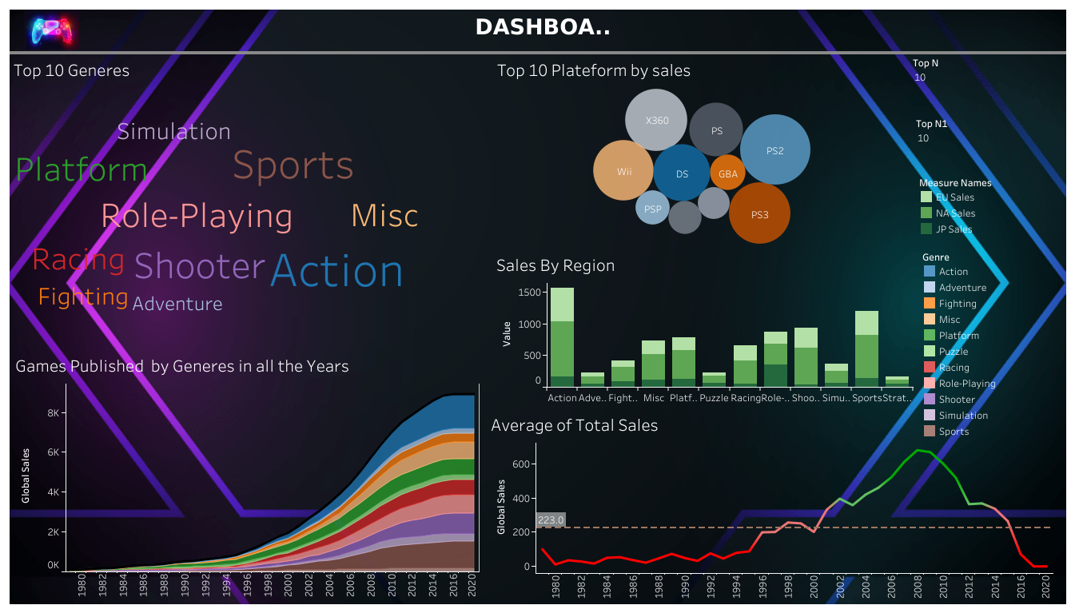

Slide 16
conclusion
PS2 is the top grossing plateform
Action is the top grossing genre
Publisher ‘Nintendo’ sold the highest number of games
Wii Sports ranks number one in terms of global across all the plateforms
Highest sales of video games occur in the year 2008 and after 2008 video games sales has been less may be lack of interest and awareness
Most popular game lovers are from North America may be other Region has lack of promotion and awareness

Slide 17
Next step
Publisher should be focus on those things where the video game sales are less like promotion, awareness, creativity so that video game sales has to be maintained on all over region.

Slide 18
Thank you

